Slide 1
MGMT-6064 PROJECT LEADERSHIP AND MANAGEMENT
Module 8: Team Effectiveness

Slide 2
Objectives
Effective vs. ineffective teams
Barriers that hinder team effectiveness
Assessing team effectiveness using GRPI
Team roles that help or threaten effectiveness
Team processes that improve effectiveness:
Conflict management
Problem solving
Interpersonal issues: Dealing with difficult team members
Notes:
Source of material for slides: Arora and Baronikian text (unless noted otherwise)

Slide 3

team building as an ongoing process (kerzner)
PM must monitor team functioning throughout project
Look for changes in performance levels, energy levels, verbal and non-verbal clues from team members, and how they interact with each other (e.g., team conflict, factions, isolation of members)
Conflict avoidance may be a sign of disengagement/ de-motivation
Frequent team meetings:
“What are we doing well” and “What areas need our attention”
Ask each team member for his/her observations, then open the discussion
Try to understand the relative significance of each problem
Propose solutions to address problems
FOLLOW-UP to see if solutions are effective
Notes:
Source: Kerzner 12e, p. 158-159
Image: http://www.magna-charta.org/resources/images/.-1/@@images/2b4e559e-3b84-4ed5-bea4-384122ad605a.jpeg

Slide 4

Effective teams
INEffective teams
High performance
Commitment
Effective conflict resolution
Trust
High energy
High morale
Adaptability
Goal orientation
Good communication
Good interpersonal relationships
Low performance
Low commitment
Unclear understanding of objectives
Uneven commitment
Unproductive relationships
Lack of communication
Conflict
Low motivation
Factions, isolation of team members
Notes:
Source: Kerzner 12e, p. 158-159
Image source: http://buildicus.com/blog/img/uploads/2015/04/Depositphotos_9196540_m.jpg

Slide 5

Barriers to team development (Kerzner)
Differing priorities/ interests/ opinions of team members
Role conflicts (ambiguity – who does what?)
Unclear project objectives (leads to conflict, power struggles)
Dynamic project environments (project changes too much)
Competition over team leadership
Lack of team definition/ structure (especially if project is supported by several departments that aren’t coordinating well)
Notes:
Source: Kerzner 12e p. 154-157
http://421653755662496554.weebly.com/uploads/1/6/9/2/16925074/4451466_orig.jpg

Slide 6
Barriers to team development (Kerzner)
Project personnel selection (e.g., functional manager & project manager have different choices for personnel)
Credibility of project leader (poor managerial skills, poor technical judgements, lack of experience)
Communication problems (from a variety of sources – e.g., intra-team, team vs PM, PM vs sponsor, PM vs other managers, etc.)
Lack of senior management support (e.g., distracted or disinterested after project launches)
Lack of team member commitment
Notes:
Source: Kerzner 12e p. 154-157
http://421653755662496554.weebly.com/uploads/1/6/9/2/16925074/4451466_orig.jpg

Slide 7
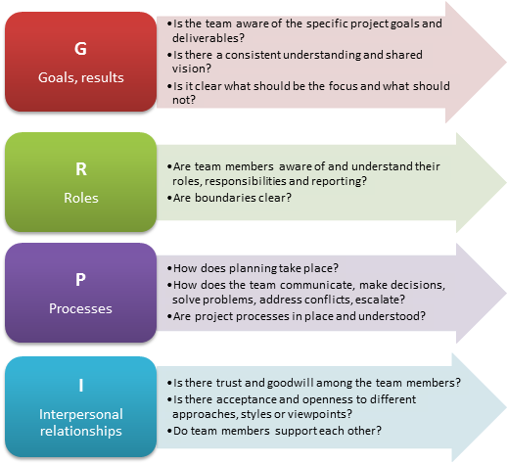
Assess team effectiveness using GRPI
GRPI is a team assessment tool with four components:
Goals
Roles
Processes
Interpersonal Relationships
Notes:
Source: Arora, M. & Baronikian, J. (2013). Leadership in project management: Leading people and projects to success (2nd ed.). Toronto: Leadership Publishing House. (pp. 226-230)

Slide 8
GRPI: Where does the team stand?
Team members can complete a GRPI assessment using a survey approach, or it could be facilitated in a team meeting
Notes:
Source: Arora, M. & Baronikian, J. (2013). Leadership in project management: Leading people and projects to success (2nd ed.). Toronto: Leadership Publishing House. (pp. 226-230)

Slide 9
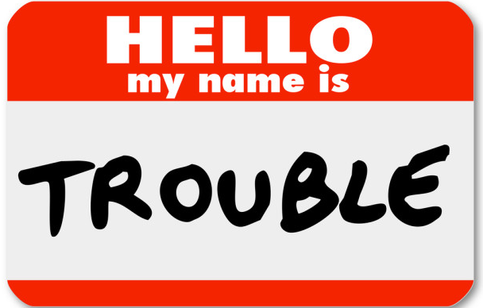
Informal Roles that Undermine Project execution (Kerzner)
The Aggressor: Critical of everything, deflates status & ego of others
The Dominator: Tries to take over, knows everything about everything, manipulative, will challenge your leadership
Devil’s Advocate: Finds fault everywhere, refuses to become a believer unless threatened
Topic Jumper: Must be the first with a new idea/approach, cannot focus on issues for long unless it is his/hers
Recognition Seeker: Always argues in favor of his/her own ideas, status conscious, likes to hear himself/herself speak, often boasts rather than providing meaningful information
The Withdrawer: Afraid of criticism, withholds info & participation, may be shy
The Blocker: Critical, rejects views of others, provides irrelevant examples & personal experiences
Notes:
Image: http://clubsolutionsmagazine.com/wp-content/uploads/2015/09/shutterstock_133999958-620x400.jpg
Info source: Kerzner 12th edition

Slide 10

Informal Roles that Support Project execution (Kerzner)
Initiators: Let’s try this!
Information Seekers: Do we know other projects where this has worked?
Information Givers: We tried this on a previous project, with successful results.
Clarifiers: Are we saying that …?
Consensus Takers: Let’s take a vote on this
Encouragers: Your idea has a lot of merit.
Harmonizers: Your ideas and mine are similar.
Gatekeepers: Who hasn’t given us their opinions on this yet?
Task Roles
Maintenance Roles
Notes:
Image: https://www.accountingweb.com/sites/default/files/styles/banner/public/happy_accountants_peopleimages.jpg?itok=OPF0NXAo
Info Source: Kerzner 12e

Slide 11
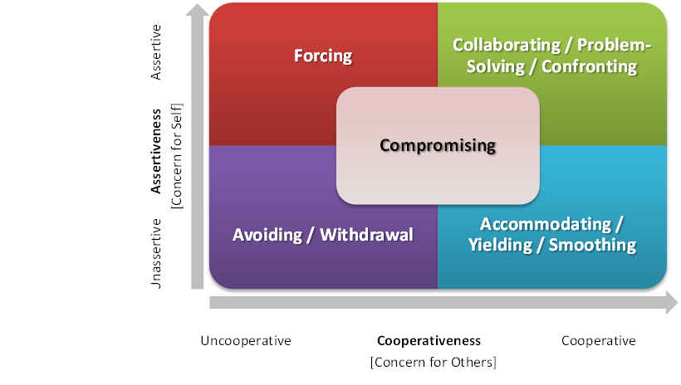
Conflict management strategies (Thomas & Kilmann)
Conflict can jeopardize project success
Conflict management is a key skill for PM (and team)
Five common strategies for resolving conflict
Dimensions are cooperativeness & assertiveness
Appropriate strategy to use depends on: issue importance, relationship importance, power (im)balance, and available time
Notes:
Source 1: https://programsuccess.wordpress.com/2013/08/01/conflict-resolution-in-project-management/ (August 1, 2013) Source 2: https://www.astridbaumgardner.com/blog-and-resources/articles/conflict-management-styles-the-start-of-effective-conflict-management/ (September 23, 2012) Source 3: https://www.riverhouseepress.com/choosing-conflict-style (n.d.)

Slide 12
MATCH THE CONFLICT MANAGEMENT STRATEGIES
I win, you lose
I win, you win
I win a bit and lose a bit, you win a bit and lose a bit
No one wins
I lose, you win
Accommodating
Avoiding
Collaborating
Compromising
Forcing
Notes:
1e
2d
3b
4c
5a

Slide 13
MATCH THE CONFLICT MANAGEMENT STRATEGIES
I’ll pick the movie this month, you pick the movie next month
Mother to child: “Don’t argue with me. Brush your teeth before bed.”
You said something offensive, but I’ll bite my tongue and won’t say anything about it
You can decide what restaurant that we go to this evening
Let’s talk about our different ideas and figure out a solution that works for both of us
Accommodating
Avoiding
Collaborating
Compromising
Forcing
Notes:
1d
2c
3e
4a
5b

Slide 14
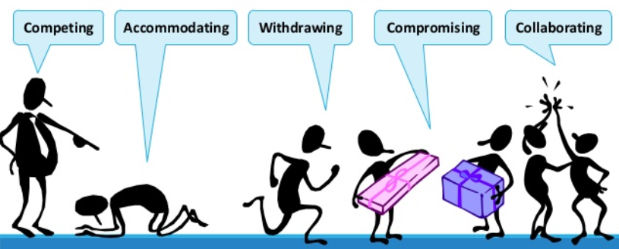
Conflict management: forcing
When to Use
You know you’re right
Time is short
Being right is more important than preserving relationships
The issue is trivial
When NOT to Use
It needlessly diminishes the other person’s self-respect
It is important to have support and cooperation of others who want to be treated as equals
When you risk over-using it
Notes:
Source 1: https://programsuccess.wordpress.com/2013/08/01/conflict-resolution-in-project-management/ (August 1, 2013) Source 2: https://www.astridbaumgardner.com/blog-and-resources/articles/conflict-management-styles-the-start-of-effective-conflict-management/ (September 23, 2012) Source 3: https://www.riverhouseepress.com/choosing-conflict-style (n.d.)
Image: https://image.slidesharecdn.com/workplaceconflict-140118215446-phpapp02/95/tips-for-reducing-and-resolving-workplace-conflict-9-638.jpg?cb=1390085835

Slide 15
Conflict management: collaborating
When to Use
Parties trust each other
People are willing to change their way of thinking
Parties need to work through hard feelings
Issues and relationships are both important
Time and energy are available for discussion
A solution is possible
When NOT to Use
Issues are trivial
Time and energy are in short supply
People aren’t interested in making the effort to mutually find a solution
The goals of the other person are clearly wrong
Notes:
Source 1: https://programsuccess.wordpress.com/2013/08/01/conflict-resolution-in-project-management/ (August 1, 2013) Source 2: https://www.astridbaumgardner.com/blog-and-resources/articles/conflict-management-styles-the-start-of-effective-conflict-management/ (September 23, 2012) Source 3: https://www.riverhouseepress.com/choosing-conflict-style (n.d.)
Image: https://image.slidesharecdn.com/workplaceconflict-140118215446-phpapp02/95/tips-for-reducing-and-resolving-workplace-conflict-9-638.jpg?cb=1390085835

Slide 16
Conflict management: compromising
When to Use
People are of relatively equal power, are equally committed to goals
For resolving parts of the problem
Issues are not complex
Time is short
There is a willingness to invest some (but not a lot of) energy in finding solutions
It is important to find a solution and work together
When NOT to Use
The problem is complex and in-depth analysis is required
A compromise solution is unacceptable
Deep principles are at stake
Notes:
Source 1: https://programsuccess.wordpress.com/2013/08/01/conflict-resolution-in-project-management/ (August 1, 2013) Source 2: https://www.astridbaumgardner.com/blog-and-resources/articles/conflict-management-styles-the-start-of-effective-conflict-management/ (September 23, 2012) Source 3: https://www.riverhouseepress.com/choosing-conflict-style (n.d.)
Image: https://image.slidesharecdn.com/workplaceconflict-140118215446-phpapp02/95/tips-for-reducing-and-resolving-workplace-conflict-9-638.jpg?cb=1390085835

Slide 17
Conflict management: avoiding
When to Use
Conflict is small
Relationships are at stake OR are unimportant
You are upset, need time to cool off
Issue is unimportant
A decision can be delayed
You have little power to resist but don’t want to give in
When NOT to Use
You are about the issues and the relationship
It is used habitually
Bad feelings might result
Your role obliges you to take a stand
Delaying a solution may make matters worse
Notes:
Source 1: https://programsuccess.wordpress.com/2013/08/01/conflict-resolution-in-project-management/ (August 1, 2013) Source 2: https://www.astridbaumgardner.com/blog-and-resources/articles/conflict-management-styles-the-start-of-effective-conflict-management/ (September 23, 2012) Source 3: https://www.riverhouseepress.com/choosing-conflict-style (n.d.)
Image: https://image.slidesharecdn.com/workplaceconflict-140118215446-phpapp02/95/tips-for-reducing-and-resolving-workplace-conflict-9-638.jpg?cb=1390085835

Slide 18
Conflict management: accommodating
When to Use
Issue is more important to other person than it is to you
You realize you are wrong
You want to ‘build credit’ for the future
Relationship is extremely important
You may face retaliation for expressing your wishes
You have little power
When NOT to Use
You may feel resentful for giving in
When over-used, perception that you are weak or lack confidence
Unacceptable conduct or incompetent work needs to be confronted
Notes:
Source 1: https://programsuccess.wordpress.com/2013/08/01/conflict-resolution-in-project-management/ (August 1, 2013) Source 2: https://www.astridbaumgardner.com/blog-and-resources/articles/conflict-management-styles-the-start-of-effective-conflict-management/ (September 23, 2012) Source 3: https://www.riverhouseepress.com/choosing-conflict-style (n.d.)
Image: https://image.slidesharecdn.com/workplaceconflict-140118215446-phpapp02/95/tips-for-reducing-and-resolving-workplace-conflict-9-638.jpg?cb=1390085835

Slide 19
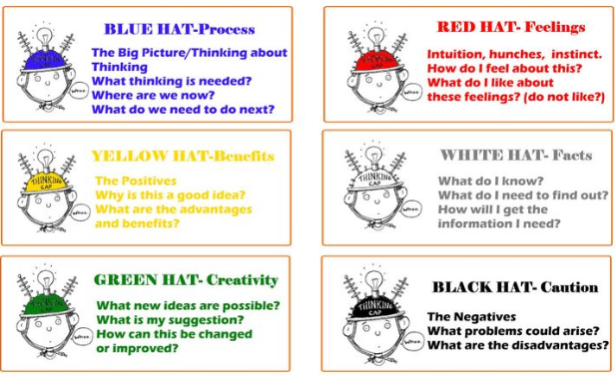
De Bono’s ‘Six hats’ problem solving approach (video)
Notes:
Another good video: https://www.youtube.com/watch?v=PASrBGtcrdU
Image: https://solesisters1.files.wordpress.com/2015/04/de_bonos_thinking_hats_1024x1024.jpg

Slide 20

Dealing with ‘difficult’ team members
De-escalate emotions
Acknowledge the problem, don’t ignore it
Don’t jump to conclusions
Pick an appropriate time and place to discuss
Listen and look for root cause(s) of the problem
Recognize your own biases
Be open-minded to different perspectives (including cultural differences)
Work with the person to find solutions
Reinforce and clarify objectives, roles, policies
Stay professional
Follow up
Escalate if necessary (e.g., to HR) or consider replacing the team member
(Video)
Notes:
Image: http://sites.psu.edu/leadership/wp-content/uploads/sites/8069/2014/07/Problem-2.jpg
Adapted from : projectbliss.net/difficult-team-member/ and hbr.org/2017/04/how-to-work-with-someone-who-isnt-a-team-player

